Slide 1
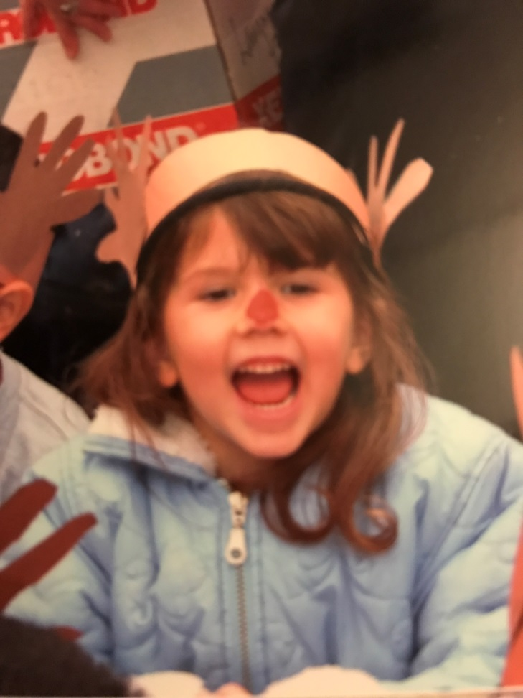
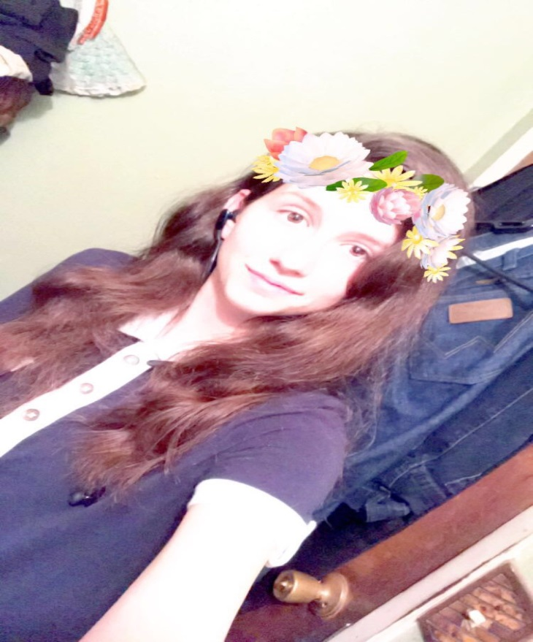
Amanda King
Class of 2017
Exit Interview

Slide 2
About me
Born in Lindsay, CA
Youngest of 3
Reading, Guitar, Music
Many struggles in life

Slide 3
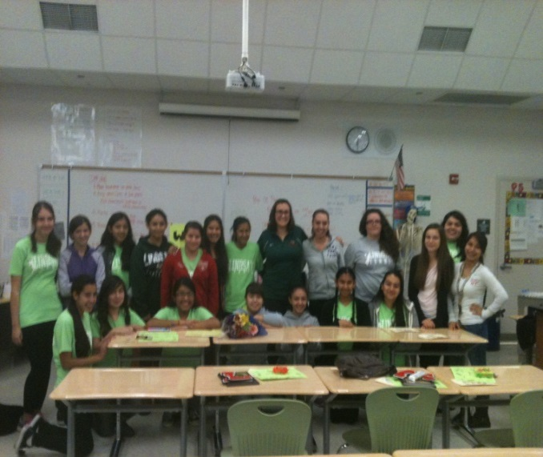
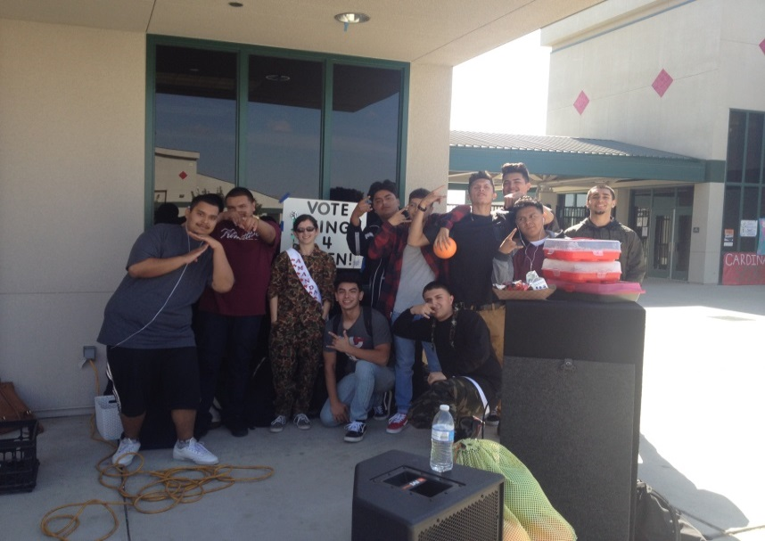
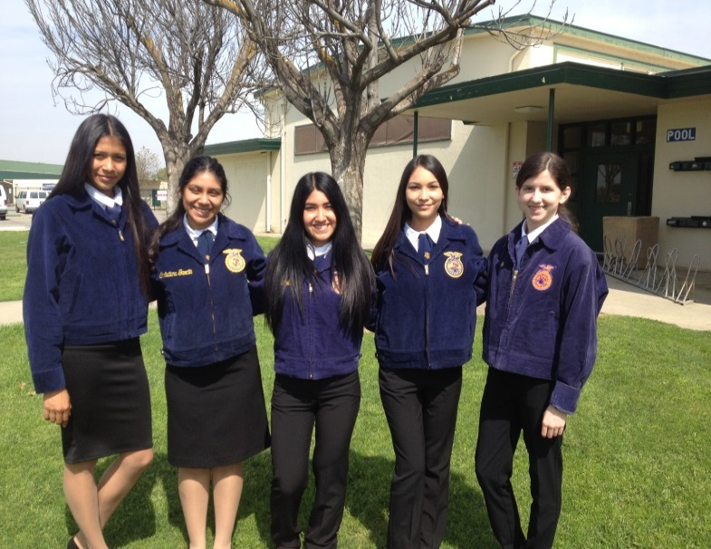
My high school experience
Clubs- FFA, ASL, ASB, Key Club, Drama
Played Tennis Freshmen year
Locked in a chicken coop
FFA competitions
Homecoming
PBS (successes and struggles)

Slide 4
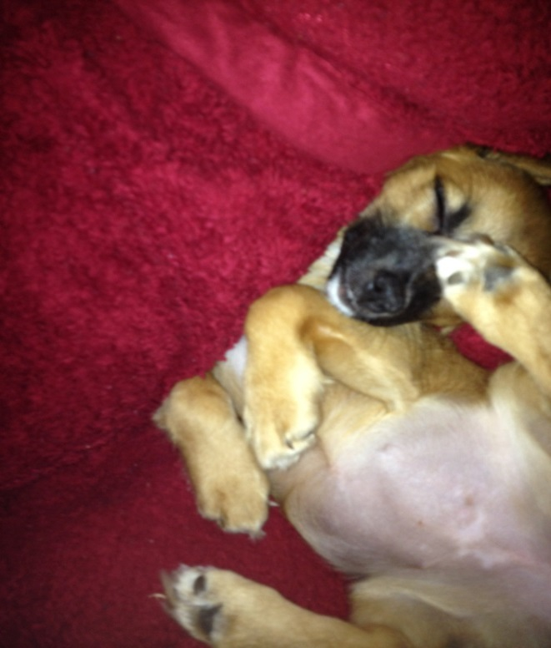
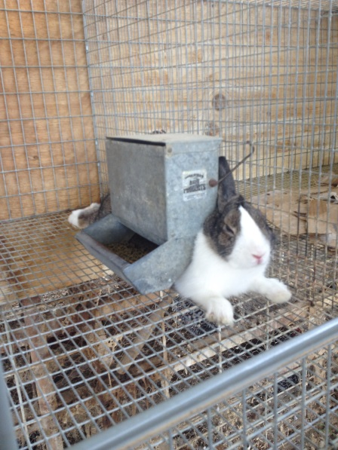
Job Shadow
Dr. Imbach- Veterinarian
All Creatures Pet Care
Always wanted to be a Vet.
Got to help diagnose a patient
Can’t handle seeing surgeries occur
No longer see myself being a Vet.

Slide 5
Struggles
Successes
Grandpa
Procrastination
First Place at Animal Disease Case Study at COS
$25 Dollar prize

Slide 6
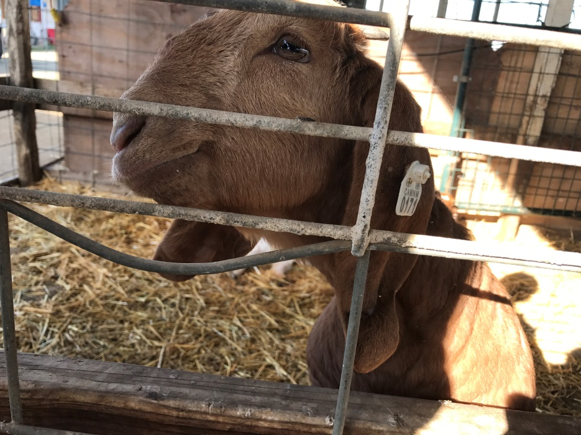
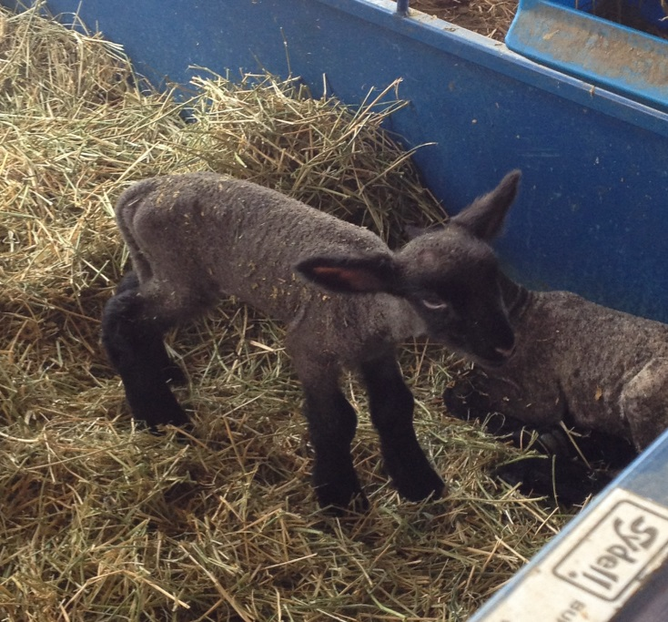
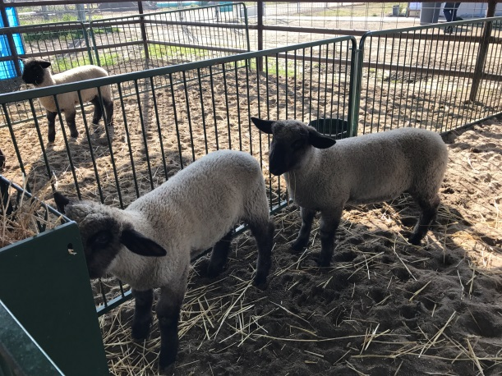
Pathway
Agriculture
Wanted to be a Vet.
Still want to work with animals
Taking good care of animals is lots of work
Animals are complicated
Agriculture isn’t just about animals

Slide 7
Post-High school plans
College of the Sequoias
Applied
Major in Animal Science
Minor in Theatre
Wanted a school not far from home
Can get essentials out of the way
Transfer to UC Davis
Goals:
Short term- Graduate and go to College
Long term- Work in a field of Agriculture

Slide 8
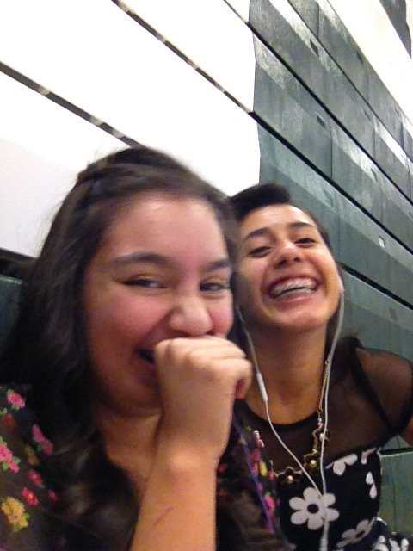
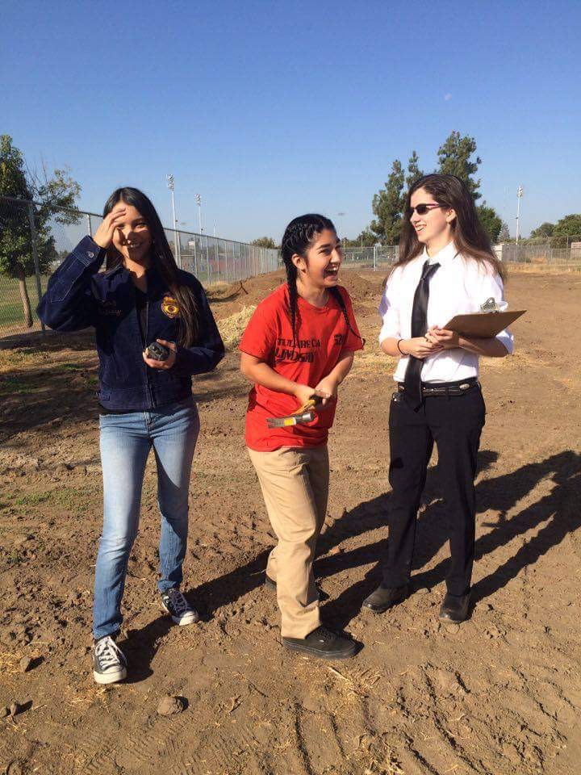
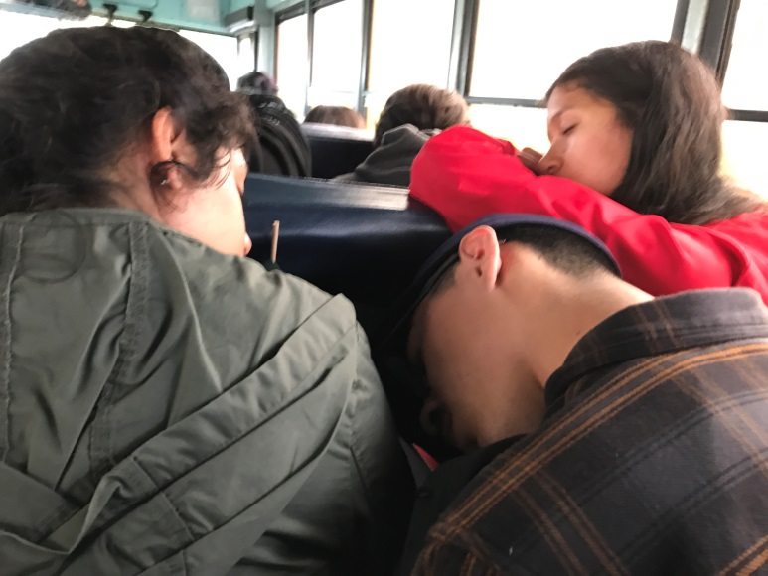
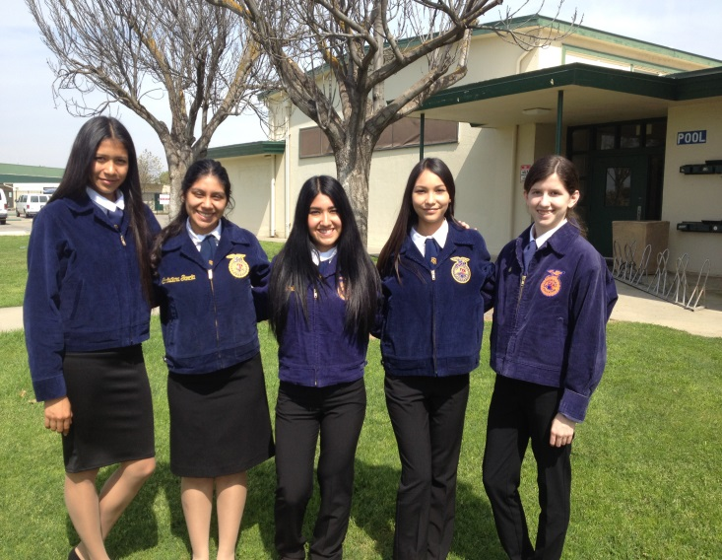
Leaving lhs
Better version of myself
Friends, Teachers, experiences
Better learner
PBS has taught me:
Perseverance when I think I’ll give up
Accountability when I mess up

